Slide 1
Linear Correlation!!!

Slide 2
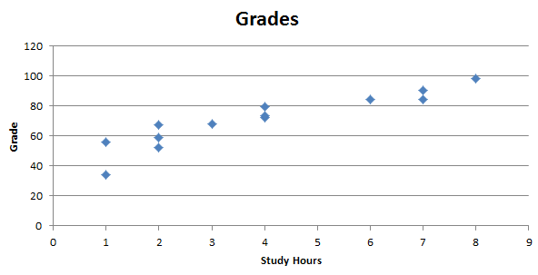
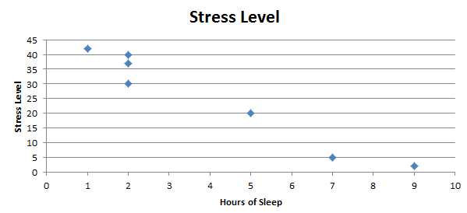
Key Concept
Examples :
Studying Hours and Grades!
Sleep v. Stress Level.
We would like a numerical measurement of the strength of the relationship between two variables representing quantitative data.
Sample Linear correlation coefficient: r

Slide 3
Exploring the Data
We can often see a relationship between two variables by constructing a SCATTERPLOT.
Notes:
Relate a scatter plot to the algebraic plotting of number pairs (x,y).

Slide 4
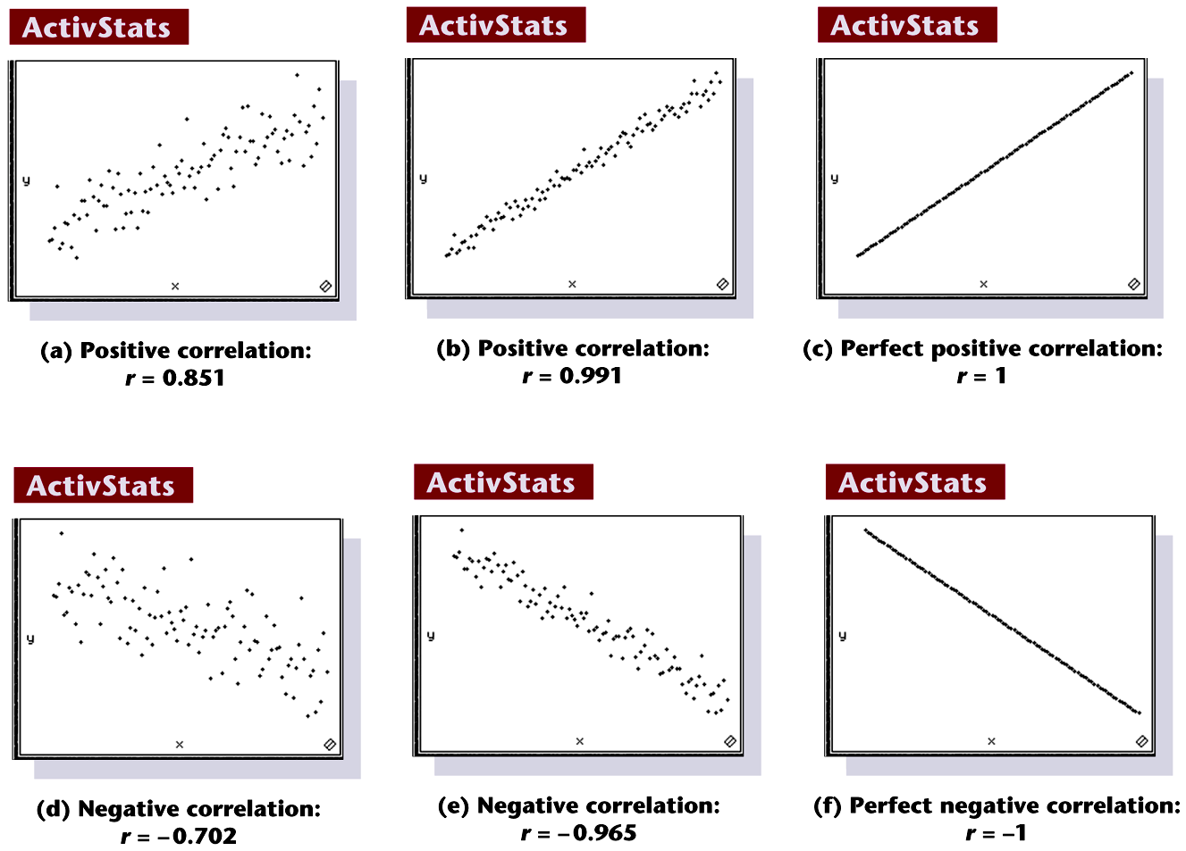
Scatterplots of Paired Data
Notes:
Page 619 of text

Slide 5
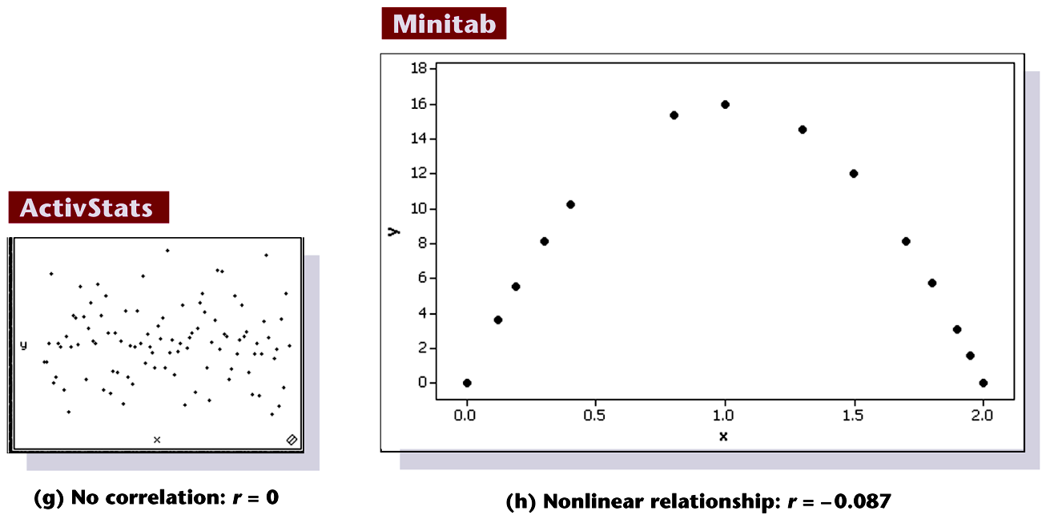
Scatterplots of Paired Data
No relationship: r = -.0045
Non linear relationship: r = .00072
Notes:
Page 619 of text

Slide 6
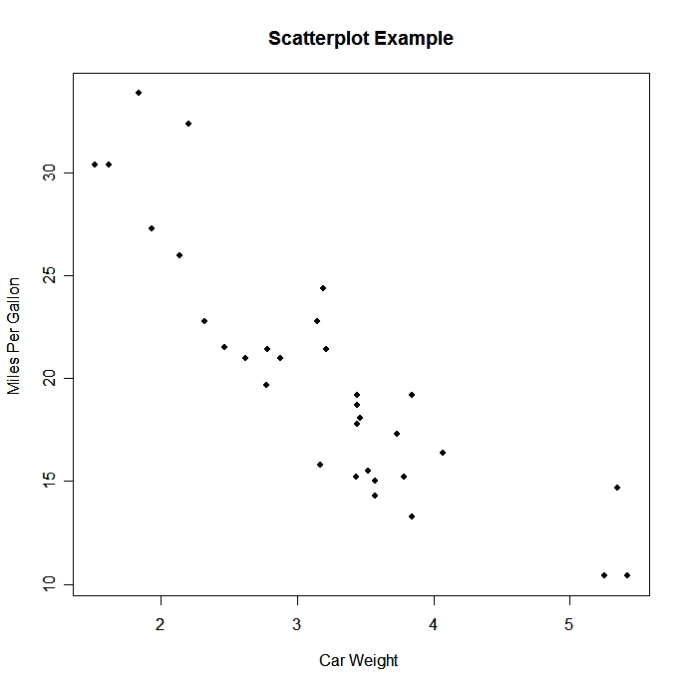

Which correlation coefficient best describes the scatter plot?
r = .32
r = 0
r = -1
r = -.78
r = -.1
r = .80

Slide 7
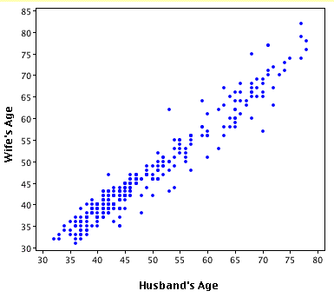
Which correlation coefficient best describes the scatter plot?
r = .32
r = -.89
r = 1
r = -.345
r = .95
r = -.5

Slide 8
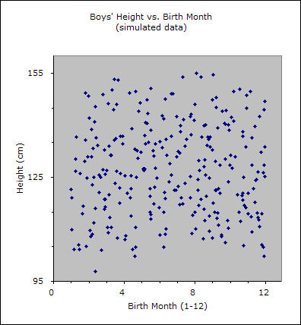
Which correlation coefficient best describes the scatter plot?
r = .28
r = -.49
r = 1
r = -.276
r = .89
r = .0003

Slide 9
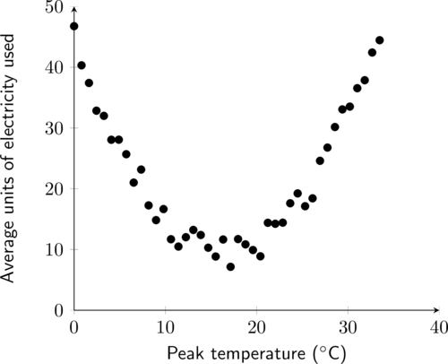
Which correlation coefficient best describes the scatter plot?
r = .32
r = -.89
r = 1
r = -.345
r = .95
r = -0.007

Slide 10
Which correlation coefficient best describes the scatter plot?
r = .32
r = -.91
r = -.743
r = -.345
r = .95
r = -0.007

Slide 11
Properties of the Linear Correlation Coefficient r
1. –1 ≤ r ≤ 1
2. The value of r does not change if all values of either variable are converted (linearly: new_x = ax +b) to a different scale. (ie. Not a transformation like a log transformation.)
3. r measures strength of a linear relationship.
Notes:
page 524 of text
If using a graphics calculator for demonstration, it will be an easy exercise to switch the x and y values to show that the value of r will not change.

Slide 12
Requirements
1. The sample of paired (x, y) data is a random sample of independent quantitative data.
2. Visual examination of the scatterplot must confirm that the points approximate a straight-line pattern.
3. The outliers must be removed if they are known to be errors. The effects of any other outliers should be considered by calculating r with and without the outliers included.
Notes:
page 520 of text
Explain to students the difference between the ‘paired’ data of this chapter and the investigation of two groups of data in Chapter 9.

Slide 13
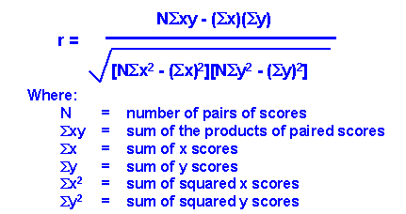
How do we find r?

Slide 14
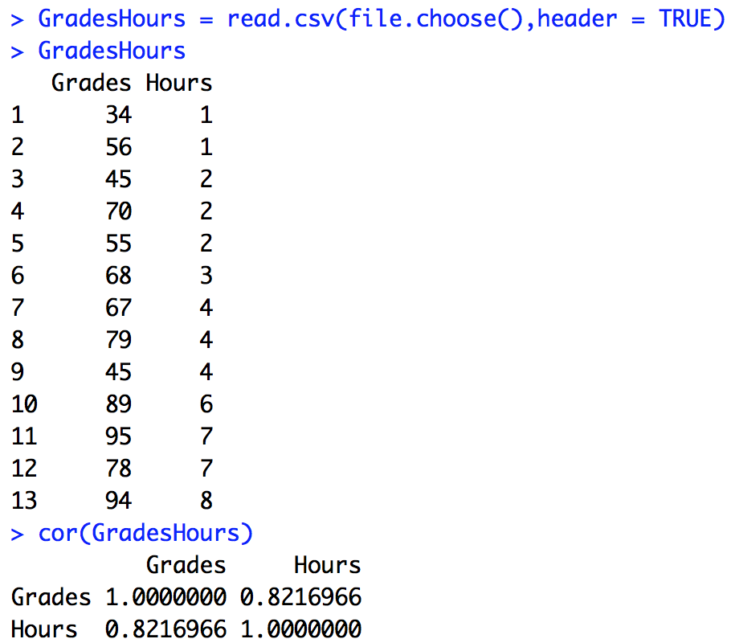
Or we can just use R!!!
There’s our sample correlation coefficient (r)!!!

Slide 15
Interpreting r² : Explained Variation
The value of r² is the proportion of the variation in y that is explained by the linear relationship between x and y.
Notes:
page 524 of text
If using a graphics calculator for demonstration, it will be an easy exercise to switch the x and y values to show that the value of r will not change.

Slide 16
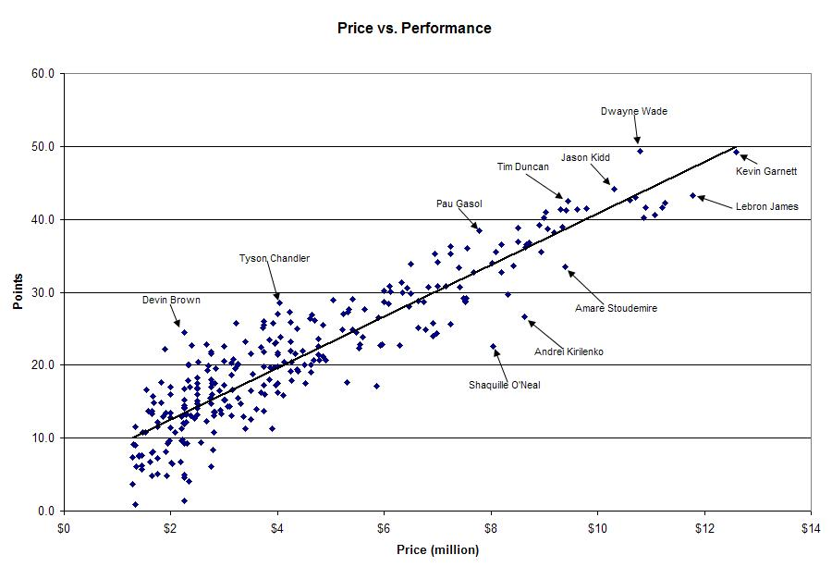
r = .907
Price explains 82.3% of the variation in point production for NBA players in this year.
r² = 0. 823

Slide 17
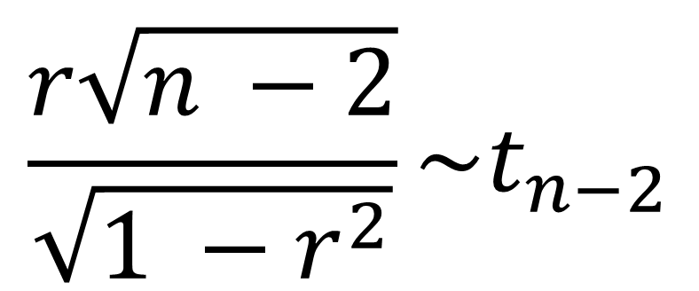
The Test Statistic!!!
$$\frac{r\sqrt{n −2}}{\sqrt{1 −r^{2}}}\sim t_{n−2}$$

Slide 18
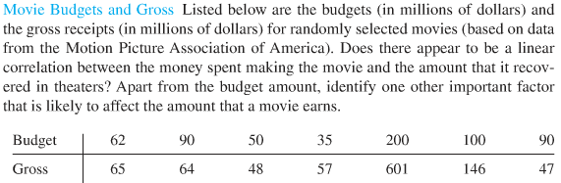
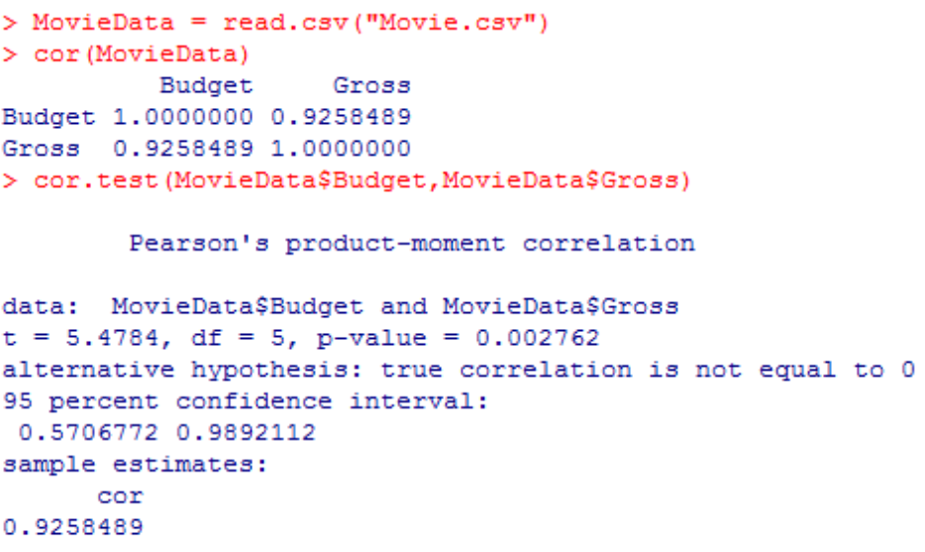
Movie Data

Slide 19
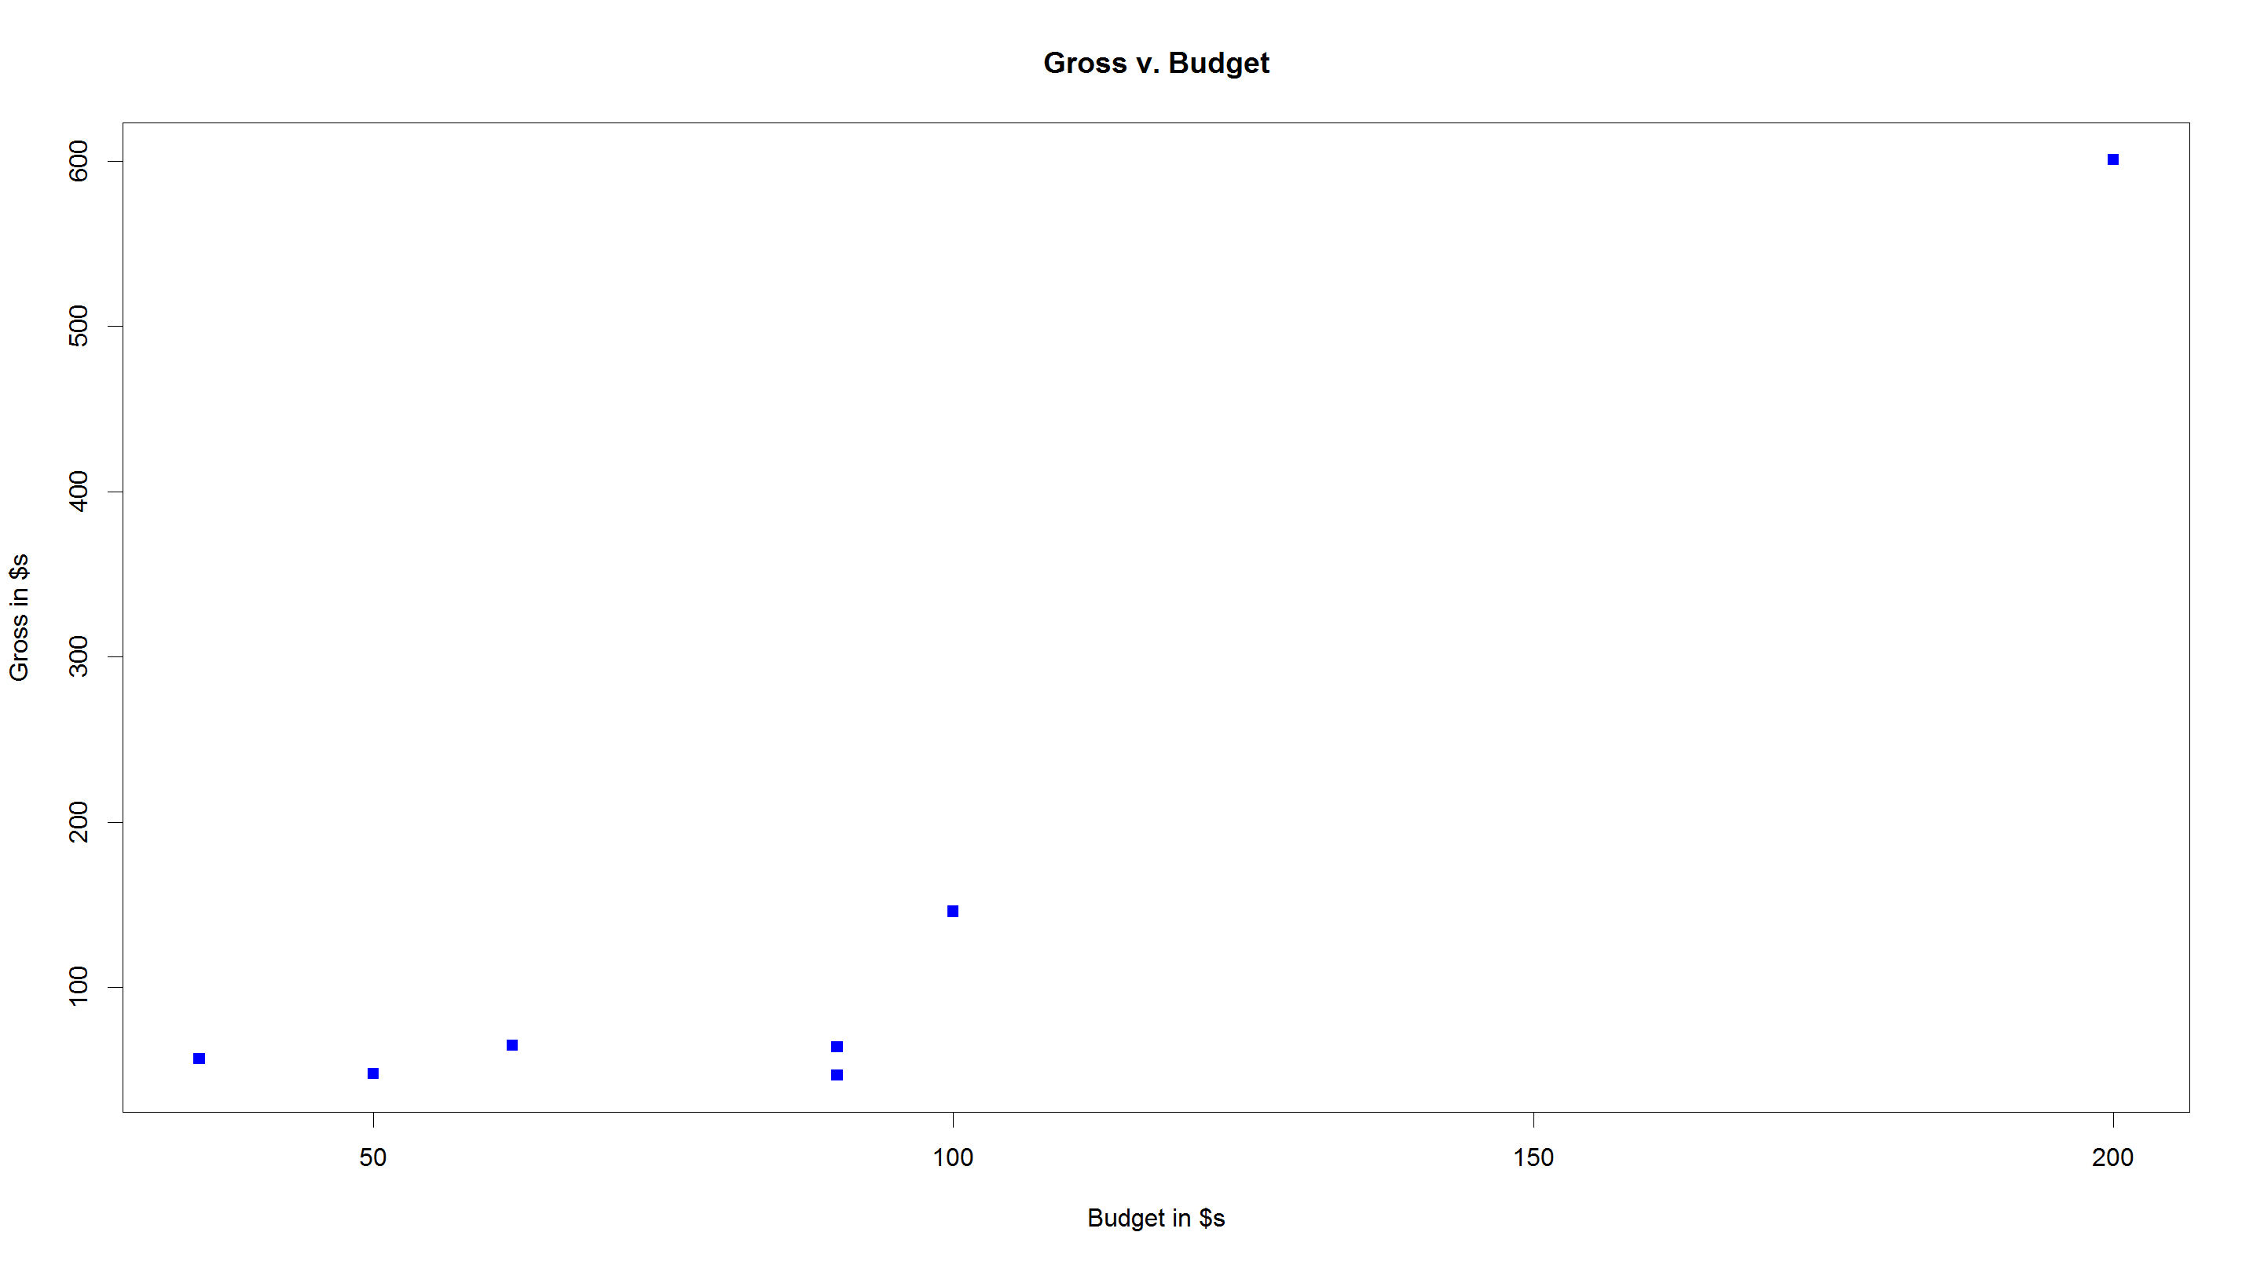
R: Movie Data
Response Variable
Explanatory Variable
Y
X
Data set
Title
Y label
X label
plot char
dot color

Slide 20
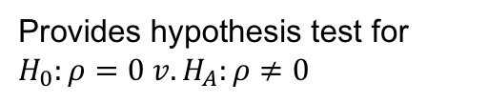
R: Movie Data
Provides hypothesis test for $H_{0}:ρ=0 v.H_{A}:ρ≠0$
Y / dependent variable
X / independent variable
pvalue = .002762
Reject Ho
There is sufficient evidence at the alpha = .05 level of significance to suggest that the data are linearly correlated (pvalue = .0028)

Slide 21
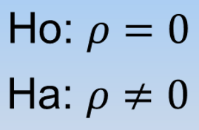
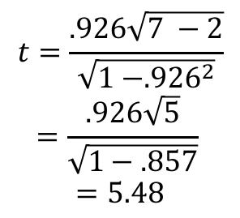
Movies!!!
$$t=\frac{.926\sqrt{7 −2}}{\sqrt{1 −{.926}^{2}}}$$
$$=\frac{.926\sqrt{5}}{\sqrt{1−.857}}$$
$$=5.48$$
Reject Ho
There is sufficient evidence at the alpha = .05 level of significance to suggest that the data are linearly correlated (pvalue = .0028)
Critical Value
t = ±02.57
pvalue =.0028
However, about r² = 86% of the variation in the Gross Sales is explained by the Movies Budget!
Other factors may include the type of movie, the actors in the movie, etc…

Slide 22
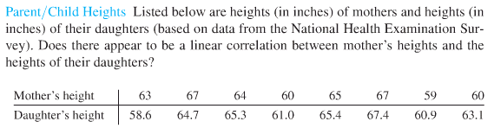
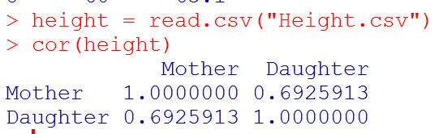
R: Parent Child Heights

Slide 23
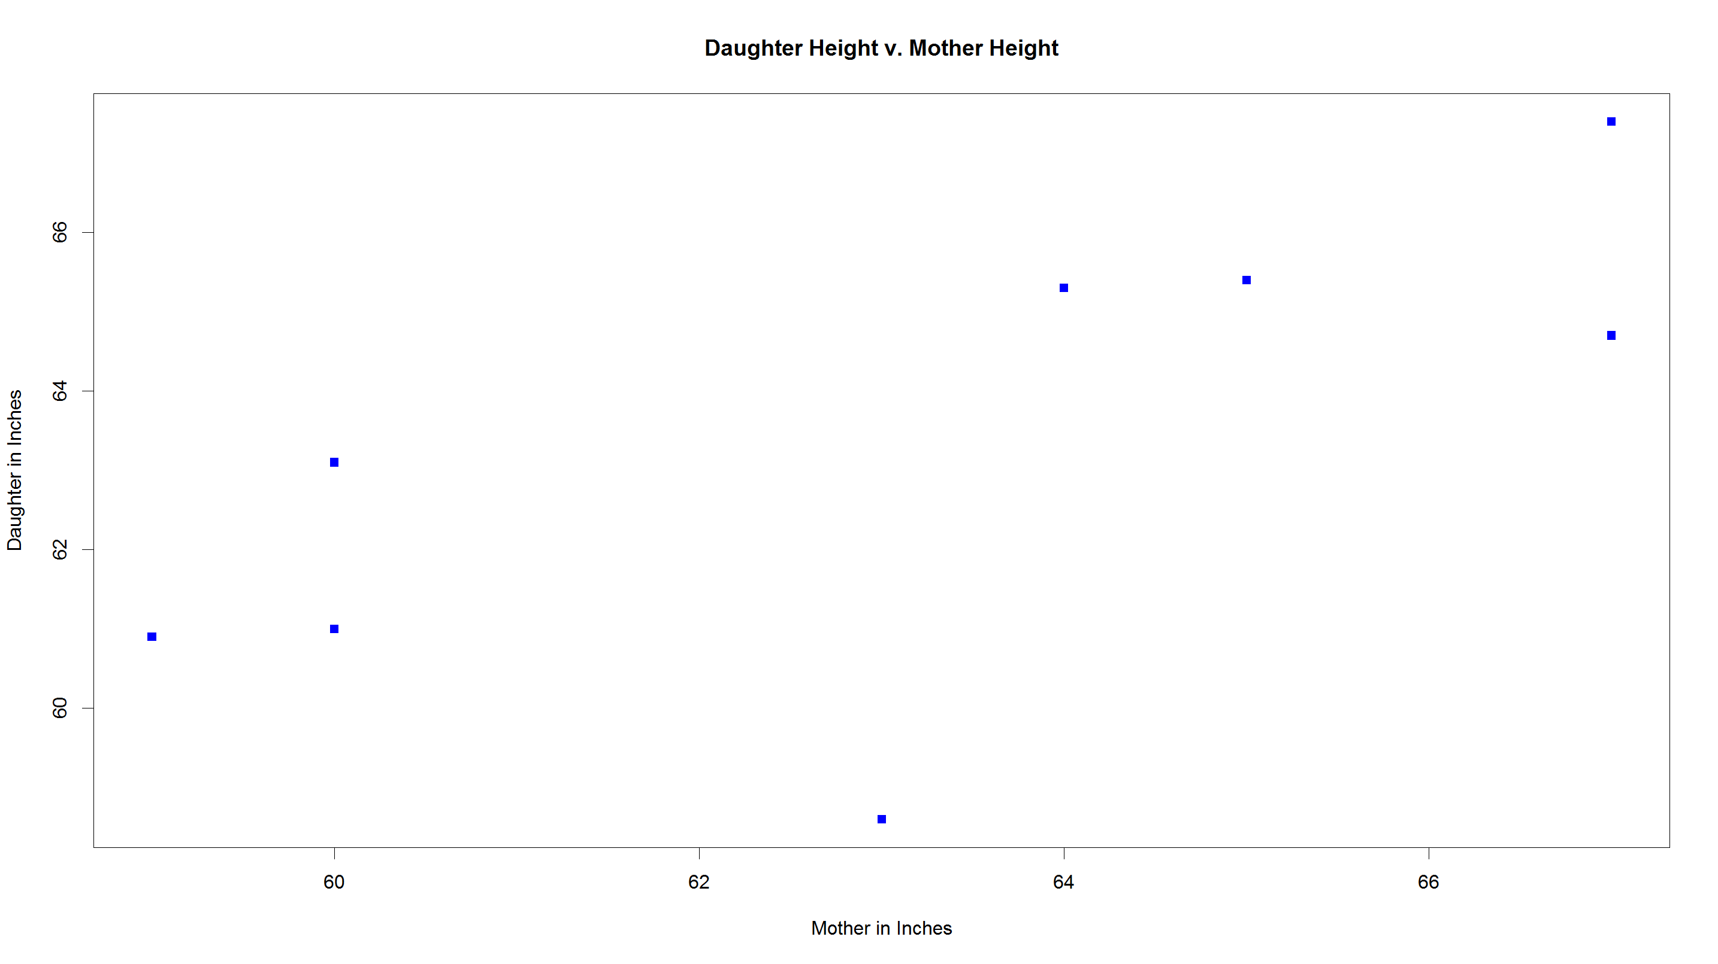
R: Parent Child Heights

Slide 24
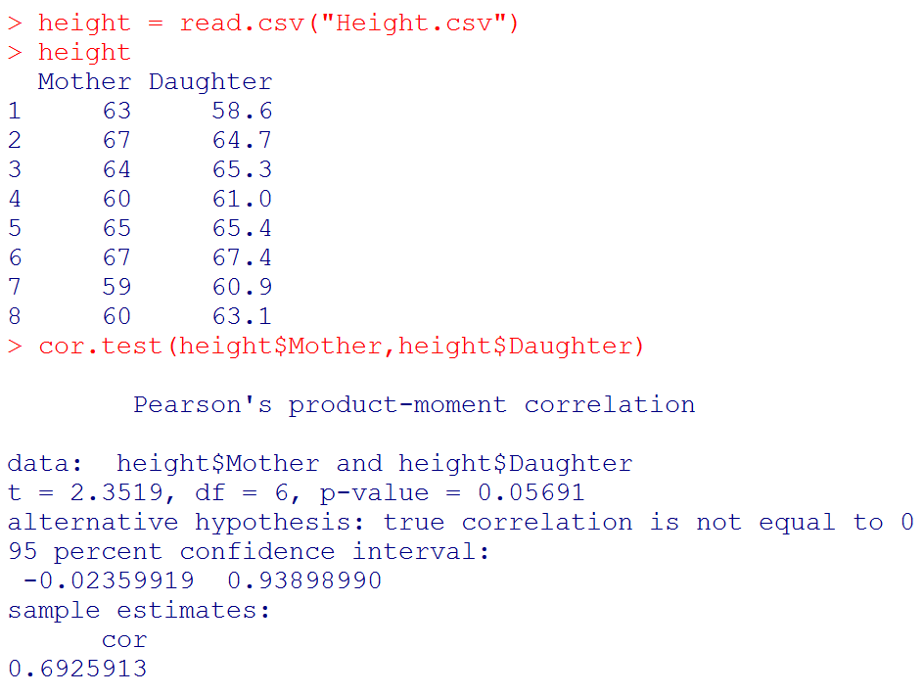
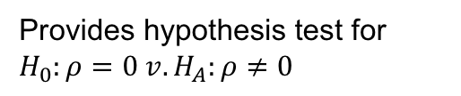
R: Parent Child Heights
Provides hypothesis test for $H_{0}:ρ=0 v.H_{A}:ρ≠0$
pvalue =
.05691
Fail to Reject Ho
There is not sufficient evidence to suggest that the mother’s and daughter’s heights are linearly correlated (pvalue = .0028).

Slide 25
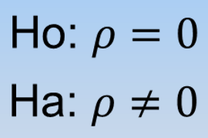
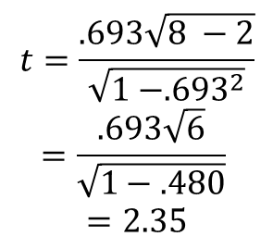
Parent/Child Heights
$$t=\frac{.693\sqrt{8 −2}}{\sqrt{1 −{.693}^{2}}}$$
$$=\frac{.693\sqrt{6}}{\sqrt{1−.480}}$$
$$=2.35$$
FTR Ho
There is not sufficient evidence at the alpha = .05 level of significance to suggest that the data are linearly correlated (pvalue = .0569).
Critical Value
±2.45
pvalue =.0569
It is estimated that r² = 48% of the variation in the daughters height is explained by the mothers height!

Slide 26
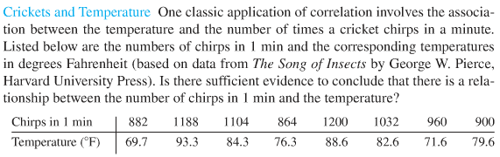
Quiz Q1: Crickets!!!
Use R to create a scatter plot of the data with cricket chirps on the y axis and temperature on the X axis. Does there appear to be visual evidence of a linear trend between cricket chirps and temperature?
Use R to find the correlation coefficient. Show your code.
Use R to find the pvalue of a hypothesis test to test for significant linear correlation between cricket chirps and temperature. Show your code.
Based on the pvalue and hypothesis test from above, write a conclusion in non statistical language with respect to the presence or absence of linear correlation.

Slide 27
Crickets!!!
Use R to create a scatter plot of the data with temperature on the y axis and time on the X axis. Does there appear to be visual evidence of a linear trend between temperature and chirps?
plot(crickets$Temp, crickets$Chirps, main = "Chirps v. Temperature Chirps", pch = 15, xlab = "Temperature", ylab = "Chirps")

Slide 28
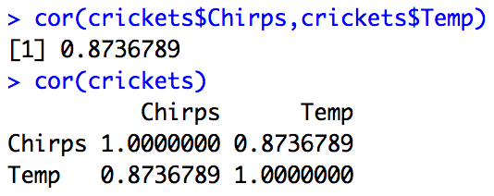
Crickets!!!
Use R to find the correlation coefficient. Show your code.
cor(crickets$Chirps,crickets$Temp)
cor(crickets)

Slide 29
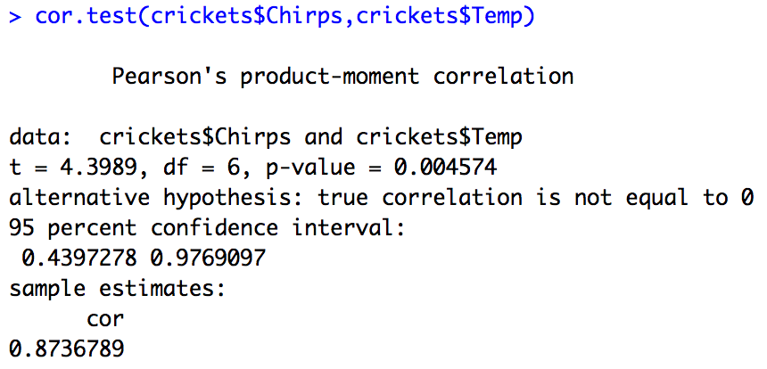
Crickets!!!
Use R to find the pvalue of a hypothesis test to test for significant linear correlation between temperature and chirps. Show your code.
pvalue = .004574

Slide 30
Crickets!!!
Based on the pvalue and hypothesis test from above, write a conclusion in non statistical language with respect to the presence or absence of linear correlation.
pvalue = .004574
There is strong evidence to suggest that the temperature and cricket chirps are linearly correlated (pvalue = .004574).

Slide 31
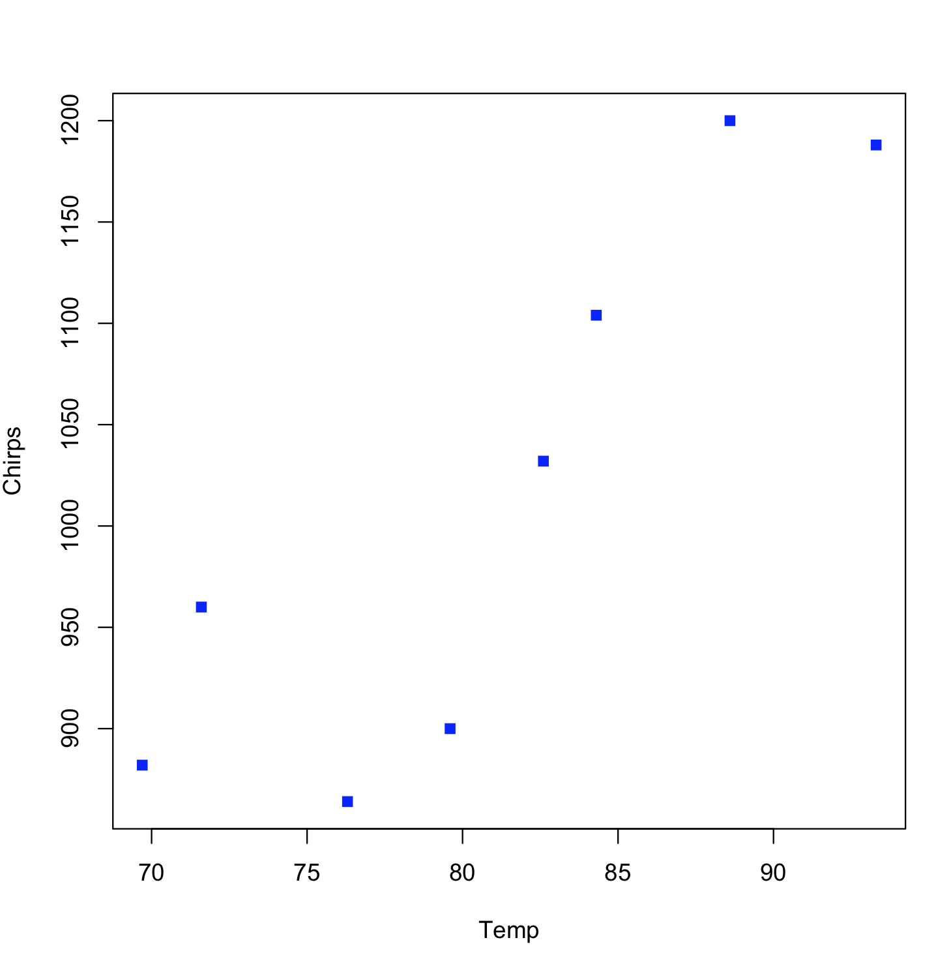
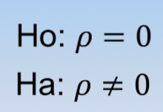
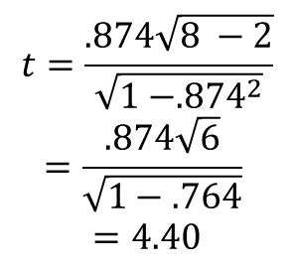
Crickets!!!
$$t=\frac{.874\sqrt{8 −2}}{\sqrt{1 −{.874}^{2}}}$$
$$=\frac{.874\sqrt{6}}{\sqrt{1−.764}}$$
$$=4.40$$
Reject Ho
There is sufficient evidence at the alpha = .05 level of significance to suggest that the data are linearly correlated (pvalue = .0046).
Critical Value
±2.45
pvalue =.0046
It is estimated that about r² = 76% of the variation in the Chirps per minute is explained by the Temperature!

Slide 32
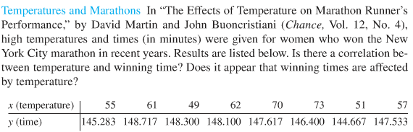
Quiz Q2: Marathons!!!
Use R to create a scatter plot of the data with temperature on the y axis and time on the X axis. Does there appear to be visual evidence of a linear trend between temperature and time?
Use R to find the correlation coefficient. Show your code.
Use R to find the pvalue of a hypothesis test to test for significant linear correlation between temperature and time. Show your code.
Based on the pvalue and hypothesis test from above, write a conclusion in non statistical language with respect to the presence or absence of linear correlation.

Slide 33
Marathons!!!
Use R to create a scatter plot of the data with temperature on the y axis and time on the X axis. Does there appear to be visual evidence of a linear trend between temperature and time?
plot(marathon$Time, marathon$Temp, main = "Temp v. Time", pch = 15, xlab = "Time", ylab = "Temp")

Slide 34
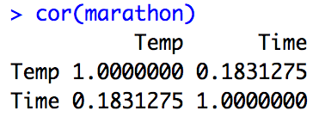
Marathons!!!
Use R to find the correlation coefficient. Show your code.
cor(marathon)

Slide 35
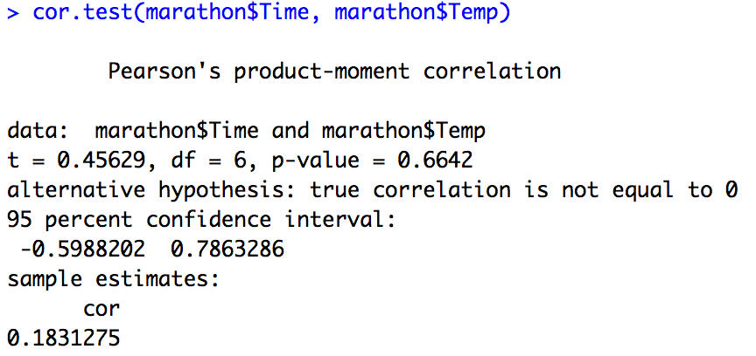
Marathons!!!
Use R to find the pvalue of a hypothesis test to test for significant linear correlation between temperature and time. Show your code.
cor.test(marathon$Time, marathon$Temp)

Slide 36
Marathons!!!
Use R to find the pvalue of a hypothesis test to test for significant linear correlation between temperature and time. Show your code.
There is not sufficient evidence to suggest that the Temperature and marathon times are linearly correlated (pvalue = .6642).

Slide 37
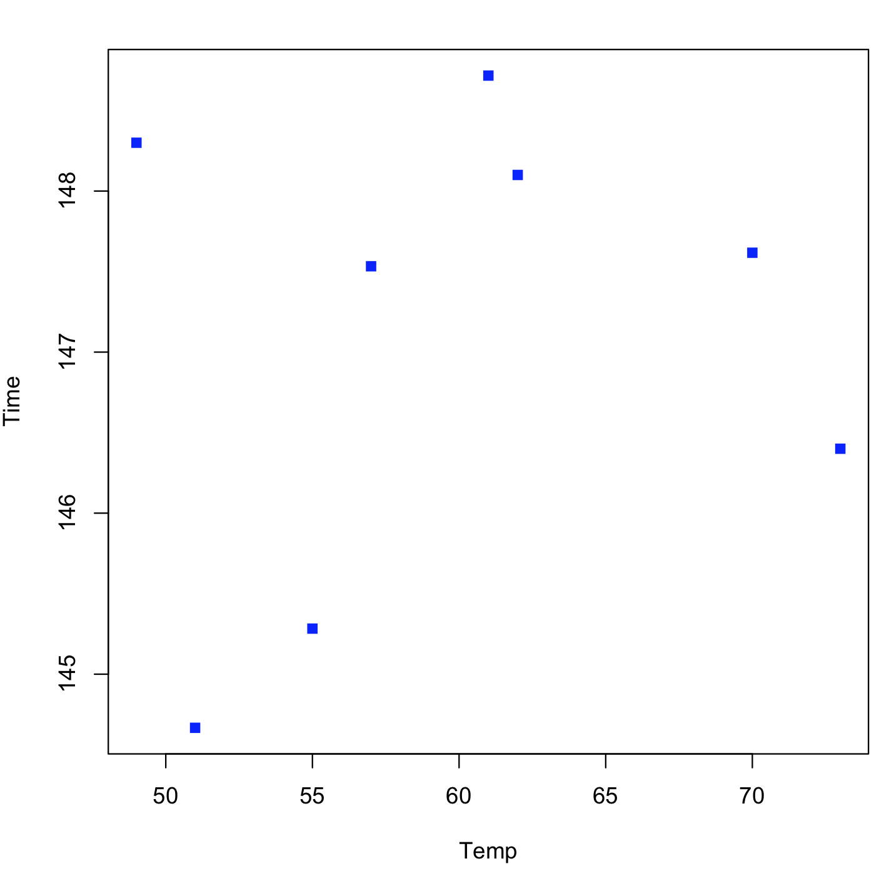
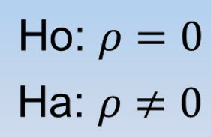
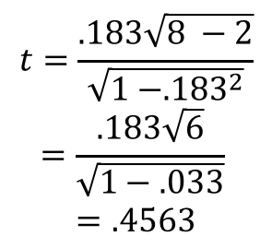
Marathons!!!
$$t=\frac{.183\sqrt{8 −2}}{\sqrt{1 −{.183}^{2}}}$$
$$=\frac{.183\sqrt{6}}{\sqrt{1−.033}}$$
$$=.4563$$
pvalue =.6642
FTR Ho
There is not sufficient evidence at the alpha = .05 level of significance to suggest that the data are linearly correlated (pvalue = .6642).
Critical Value
±2.45
Only about r² = 3% of the variation in the winning times from the sample is explained by the Temperatures in the sample! However, since there is not enough evidence to suggest linear correlation exists, there is not enough evidence to suggest this extends to the population.

